Slide 1
Kannada Speech Recognition
Guide: Dr Jayalakshmi D.S (Associate Professor)
Team Members: Rishi Kumar P S
Darshan R Konnur
Sathvik K P
Priya S

Slide 2
Agenda
Introduction
Problem Definition
Literature Survey
Current Methodology
Proposed Methodology
System Requirements
Design
System Architecture
Algorithm
Choice of Architecture
Implementation Details
Testing
Results
Significance of the Proposed Work
Conclusion and Scope
References

Slide 3
Introduction
Speech Recognition is the ability of a machine or program to identify words or phrases in spoken language and convert them to a machine readable format.
Developing a speech recognition system in Kannada is necessary as this can be of great use in providing subtitles to educational videos, historical videos, news, reports, speeches, debates etc.,

Slide 4
Problem Definition
The absence of a free program or a system which effectively provides transcripts to a video or audio file in Kannada Language is a major issue.
If such transcripts have to be provided, then a human has to manually provide them. This is very labour intensive job and majorly ineffective.
Hence the lack and availability in the development of an effective speech recognition system is Kannada is the concerned problem.

Slide 5
Literature survey
A few open source tools such as CMU Sphinx, HTK, Julius and Kaldi have been in vogue for the past few years and significant work has been accomplished using the open source tools. ASR had its inception in 1970.
In recent times, tremendous growth in ASR has been observed globally, in many different languages like English, Mexican, Italian, Serbian, Arabic etc.,
Google has been a pioneer in developing ASR systems and has developed for many languages all across the globe.

Slide 6
Current Methodology
So far, in developing Kannada ASR systems various techniques such as CMU Sphinx, Mel Frequency Cepstral Co-efficients (MFCC), Hidden, Gaussian Markov Models (GMM), HMM-GMM hybrid, Baum-Welch algorithm, Bayesian Models have been used.
Since the results and accuracy using the above methods were not great, we are using HTK toolkit in our project.

Slide 7
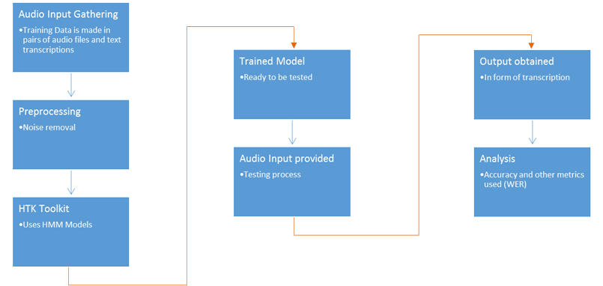
Proposed Methodology

Slide 8
Stages
Dataset Preparation
Data Pre-processing
Feature extraction
Training the model
Testing

Slide 9
System Requirements
Hardware Requirements:
Good mic for recording
2 GB RAM (Minimal)
Disk space of 512 MB - 1GB
Software Requirements:
Operating System: Linux Ubuntu/Windows XP/7/8/10
HTK toolkit
A Kannada word processor

Slide 10
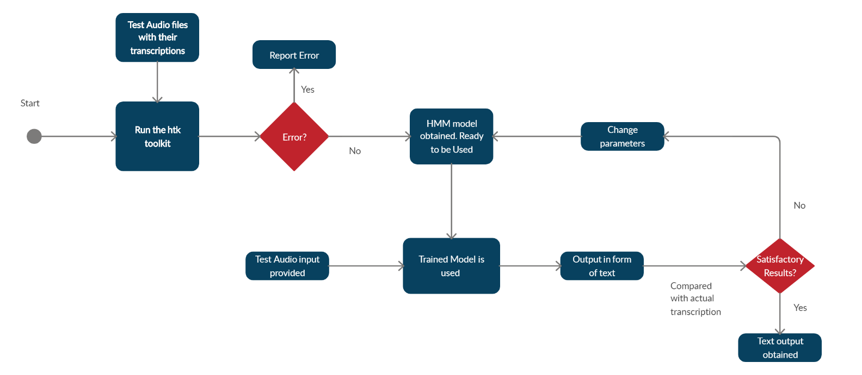
Flow Diagram (High Level)

Slide 11
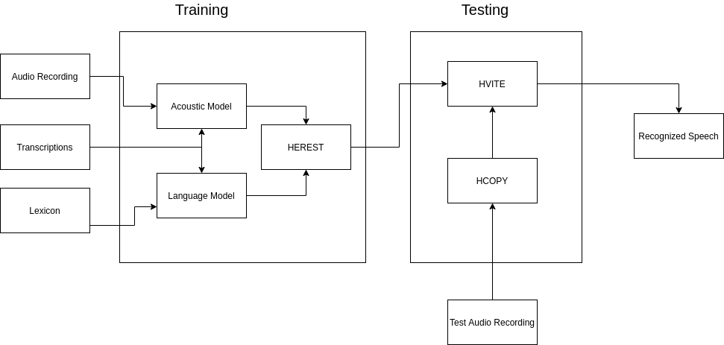
System Architecture

Slide 12
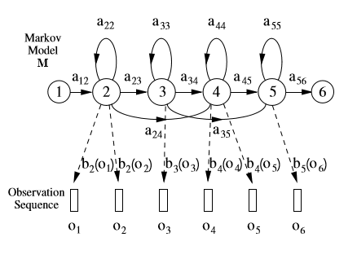
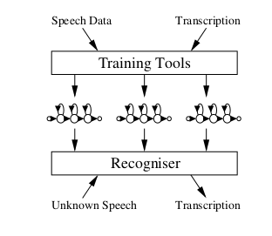
Algorithmic Description : Hidden Markov Toolkit and Hidden Markov Model
a: probability; b(o): density function with occurrence o; 1,2,3… : States

Slide 13
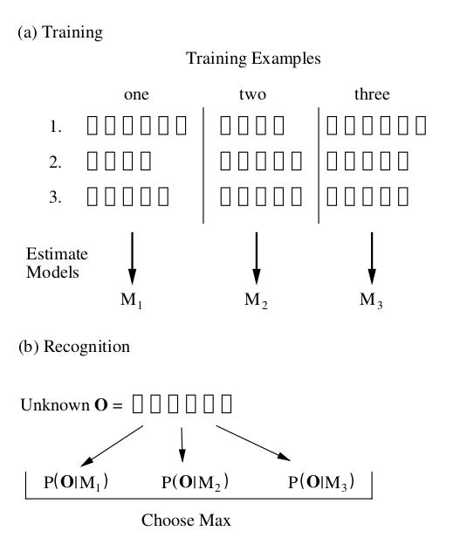
Example
Consider 3 words ‘one', 'two’ and ‘three.’
3 instances of all 3 above words are chosen to generate a model for each.
Unknown word is then predicted using conditional probability.

Slide 14
Reasons for choice of architecture
Hidden Markov Models yield the best results for speech recognition
Hidden Markov Toolkit (HTK) provides many useful sophisticated libraries and tools for speech processing, recognition and for generating HMMs
HTK has inbuilt libraries which makes it easy for analysis and for obtaining results, making the testing process easy.

Slide 15
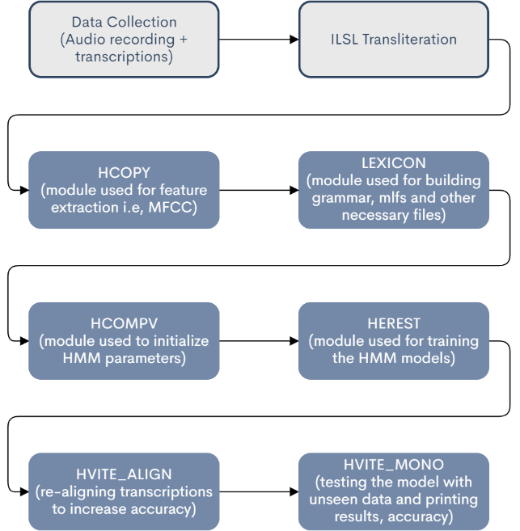
Implementation Details
Implemented on Ubuntu OS
Pre - requisites: CShell, Python

Slide 16
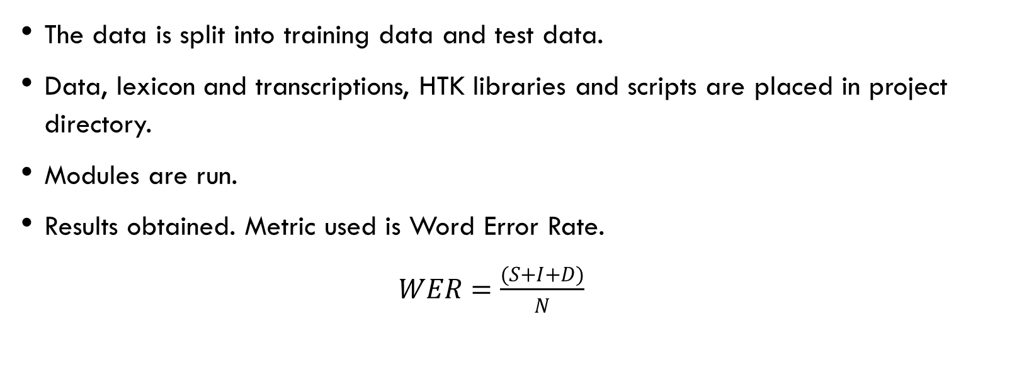
Testing
The data is split into training data and test data.
Data, lexicon and transcriptions, HTK libraries and scripts are placed in project directory.
Modules are run.
Results obtained. Metric used is Word Error Rate.
$WER=\frac{(S+I+D)}{N}$

Slide 17
Results
SENT: %Correct=50.00 [H=14, S=14, N=28]
WORD: %Corr=83.64, Acc=72.73 [H=138, D=3, S=24, I=18, N=165]
H: Correctly predicted instances, N: Total number of instances
D: Deletion Errors, S: Substitution Errors, I: Insertion Errors

Slide 18
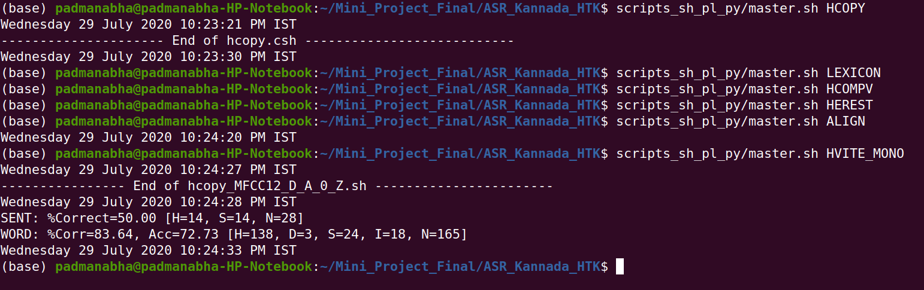
Results Snapshots: Overall Execution
Master script is provided name of modules as arguments.

Slide 19
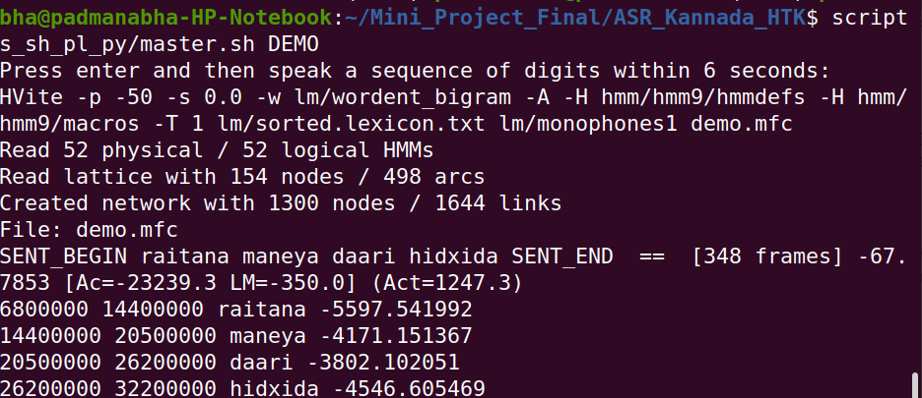
Testing for an audio file
An audio file was provided and it’s transcriptions with accuracy are printed on screen.

Slide 20
Significance of the Proposed Research Work
Speech recognition is still a domain which is yet to be completely explored.
Kannada is one of hundreds of languages which does not have easily available ASR systems. The System developed by us has helped us with knowledge on how to build a better system and the steps in order to achieve it.
We also have the results which are satisfactory and can be of great help to other researchers trying to achieve the same purpose.

Slide 21
Conclusion and Scope for Future Work
Proper pre-processing of data must be taken care of. This involves transliteration into ILSL format. A proper way to convert data into this format without errors has to be proposed.
Phone level decomposition is also a huge task and more efficient ways to achieve this must be developed.
ASR systems can be extended to other real time applications such as video software to provide real time transcriptions. The same can be applied for audio players. The integration of ASR Systems into real time applications must be developed.

Slide 22
References
Terhiija, Viyazonuo, Priyankoo Sarmah, and Samudra Vijaya. "Development of Speech Corpus and Automatic Speech Recognition of Angami." 22nd Oriental-COCOSDA, Cebu, Philippines (2019).
Deka, Barsha, Priyankoo Sarmah, and Samudra Vijaya. "Assamese Database and Speech Recognition."
Patel, Chirag, and Sunil Kopparapu. "Reusing automatic speech recognition platform for resource deficient languages." In 2014 8th International Conference on Signal Processing and Communication Systems (ICSPCS), pp. 1-5. IEEE, 2014.
Nasib, Abdullah Umar, Humayun Kabir, Ruhan Ahmed, and Jia Uddin. "A real time speech to text conversion technique for bengali language." In 2018 International Conference on Computer, Communication, Chemical, Material and Electronic Engineering (IC4ME2), pp. 1-4. IEEE, 2018.
Mittal, Puneet, and Navdeep Singh. "Development and analysis of Punjabi ASR system for mobile phones under different acoustic models." International Journal of Speech Technology 22, no. 1 (2019): 219-230.

Slide 23
Kumar, Yogesh, and Navdeep Singh. "A Comprehensive View of Automatic Speech Recognition System-A Systematic Literature Review." In 2019 International Conference on Automation, Computational and Technology Management (ICACTM), pp. 168-173. IEEE, 2019.
Hemakumar, G., and P. Punitha. "Large Vocabulary Speech Recognition: Speaker Dependent and Speaker Independent." In Information Systems Design and Intelligent Applications, pp. 73-80. Springer, New Delhi, 2015.
Kumar, Rohit, S. Kishore, Anumanchipalli Gopalakrishna, Rahul Chitturi, Sachin Joshi, Satinder Singh, and R. Sitaram. "Development of Indian language speech databases for large vocabulary speech recognition systems." In Proceedings of SPECOM. 2005.
Kannadaguli, Prashanth, and Ananthakrishna Thalengala. "Phoneme modeling for speech recognition in Kannada using Hidden Markov Model." In 2015 IEEE International Conference on Signal Processing, Informatics, Communication and Energy Systems (SPICES), pp. 1-5. IEEE, 2015.
Unnibhavi, Anand H., and D. S. Jangamshetti. "Development of Kannada Speech Corpus for Continuous Speech Recognition." International Journal of Computer Applications 975: 8887.
Sneha, V., G. Hardhika, K. Jeeva Priya, and Deepa Gupta. "Isolated Kannada speech recognition using HTK—A detailed approach." In Progress in Advanced Computing and Intelligent Engineering, pp. 185-194. Springer, Singapore, 2018.

Slide 24
Sharma, Roshan S., Sri Harsha Paladugu, K. Jeeva Priya, and Deepa Gupta. "Speech Recognition in Kannada using HTK and Julius: A Comparative Study." In 2019 International Conference on Communication and Signal Processing (ICCSP), pp. 0068-0072. IEEE, 2019.
Sahana, T., Naga Srilasya, K. Jeeva Priya, Deepa Gupta, and S. Vinay. "Comparison of different Acoustic Models for Kannada language using Kaldi Toolkit." In 2018 International Conference on Advances in Computing, Communications and Informatics (ICACCI), pp. 2415-2420. IEEE, 2018.
Ananthakrishna, T., M. Maithri, and Kumara Shama. "Kannada word recognition system using HTK." In 2015 annual IEEE India conference (INDICON), pp. 1-5. IEEE, 2015.

